Slide 1
Prokaryotic and Eukaryotic
Biology Unit 1 A Deeper Look

Slide 2
Prokaryotic vs Eukaryotic Cells
Watch this 5 minutes video
What new information is covered?
Pay attention to the hints given to assist in remember the differences and similarities between the two cells.
What type of cell is likely to have Chloroplast?

Slide 3
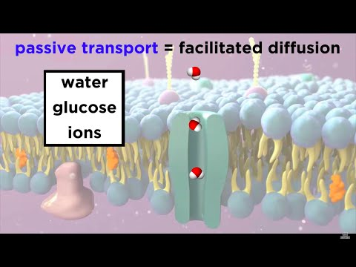
The Plasma Membrane
Watch the video and consider the following questions:
If the cell membrane did not exist, what would you hypothesize would occur?
What is ATP?
What types of proteins exist within the cell membrane?

Slide 4
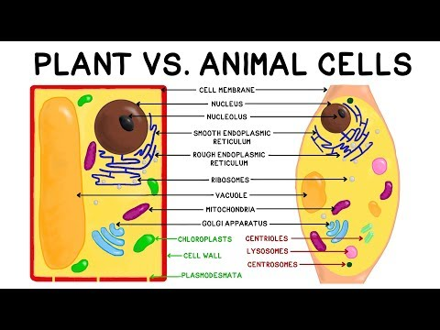
Plant vs Animal Cells
Watch the video and consider the following questions:
Do plant and animal cells have more similarities or differences?
Why do plant and animals cells differ the way they do?

